Slide 1
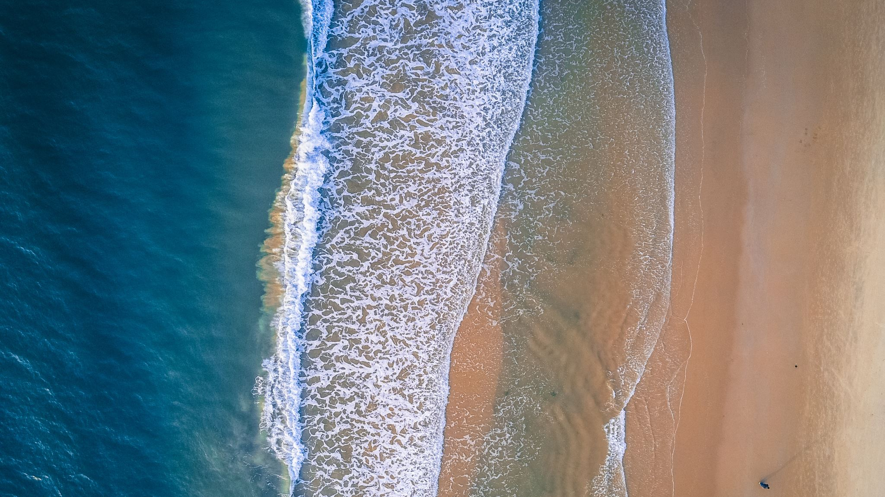
How can we make Aberdeen beaches safer?

Slide 2
Swimmer detection
Yolov8
Own model

Slide 3
Risk assessment

Slide 4
Distance calculations

Slide 5
Clustering

Slide 6
What’s next

Slide 7


